Slide 1
X-ray Radiation Safety Training

Slide 2
Aim
The aim of this presentation is to provide a basic knowledge in ray radiation protection to satisfy the requirements of Regulation 15 of the Ionising Radiations Regulations 2017.
“Every employer shall ensure that those of his employees who are engaged in work with ionising radiation are given appropriate training in the field of radiation protection…”

Slide 3
Radiation Safety Legislation

Slide 4

International Commission on Radiological Protection (ICRP)
1928 2nd International Congress of Radiology set up a commission:
  as an appropriate body to give guidance in the use of radiation sources
  as an international authority in the field of radiation
Notes:
ICRP publications as they appear today were first published in 1958 with ICRP 1.

Slide 5
ICRP 60 (Published 1990)
3 principles
Justification – there should be a net benefit
Optimisation – restriction of exposure by As Low As is Reasonably Practicable (ALARP) principles
Limitation – set dose limits should not be exceeded
Notes:
ICRP 60 introduced a new system for dose control and restriction of exposure, which was also incorporated into UK legislation
ALARP – As Low As Is Reasonably Practicable (UK)
ALARA – As Low As Is Reasonably Achievable (USA)

Slide 6
Development of UK Legislation
ICRP Principles
European Atomic Energy Committee (EURATOM) Directives
Health and Safety at Work etc Act 1974
Ionising Radiations Regulations 2017
Approved Code of Practice L121
Guidance Notes
University Policy and Guidance ‘Work with Ionising Radiation’
School / Service Local Radiation Safety Rules
Notes:
EURATOM = European Atomic Energy Committee

Slide 7
Annual dose limits
 | Whole body | Extremities and skin | Lens of the eye
Employees aged 18 and over | 50 mSv | 500 mSv | 20 mSv
Trainees aged 18 and under | 6 mSv | 150 mSv | 15 mSv
Any other person | 1 mSv | 50 mSv | 15 mSv
Women of reproductive capacity - exposure of abdomen limited top 13 mSv in any consecutive 3 month period.
Notes:
Dose limits also used to classify designated areas – Supervised / Controlled
Pregnant and breast-feeding females – 1mSv limit for the term of the pregnancy

Slide 8
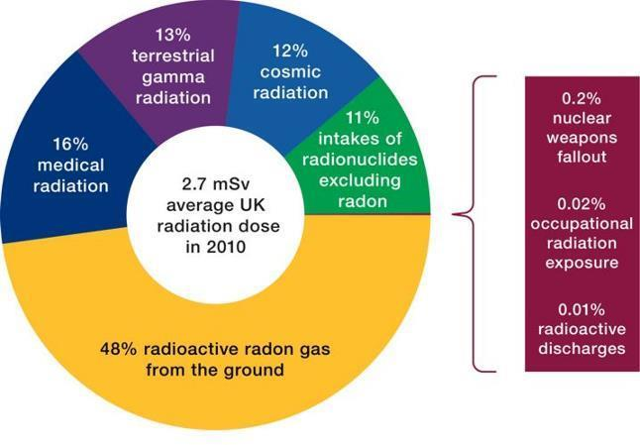
Notes:
As can be seen from the chart the biggest contributors are medical exposure and sources of natural radioactivity.

Slide 9
Ionising Radiations Regulations 2017
Notification of practices, including justification
Radiation Risk Assessments
Restriction of exposure
Local Rules
Appointment of RPA and RPS
Designation of Classified Persons
Designation of Controlled and Supervised Areas

Slide 10
Ionising Radiations Regulations 2017 continued
Dose assessment and recording
Information, instruction and training
Pregnant and breast feeding female employees
Arrangements for the control of radioactive substances, articles and equipment including loss or theft
Duties of employees

Slide 11
X-Ray Radiation

Slide 12
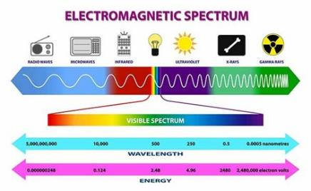
Radioactive decay
Alpha, Beta and Neutron - particles
Gamma and X-ray – electromagnetic radiation
Notes:
All radiation and radioactive particles have characteristic energies
X-ray radiation is electromagnetic radiation of high energy

Slide 13
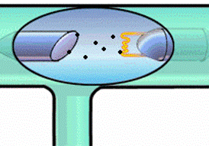
X-Ray production
Changes in electron orbit
Slowing down electrons
Slowing down beta particles (Bremsstrahlung)
High Voltages
Notes:
X-rays are generated by electron interactions

Slide 14
X-Ray production
X-rays are capable of traversing great distances and can penetrate material
However, they can be blocked or attenuated by shielding made from dense materials such as lead and concrete
Notes:
X-rays are generated by electron interactions

Slide 15
Energy of Radiation
Most of the radiation from an X-ray set is multienergetic
Range of energies can be varied -
  Increasing the voltage (kV), increases intensity of the X-ray beam, as does
  Increasing the current (mA)

Slide 16
Primary Beam and Scatter Radiation
Primary Beam
The primary beam is a significant hazard, even very short exposure times can result in severe radiation burns
Scatter radiation
Produced when the primary beam interacts with samples and structures in the X-ray enclosure. Scatter radiation is a hazard near the sample
Leakage radiation
From the X-ray tube is very low and not a hazard when the tube housing is intact

Slide 17
Radiation Dose Quantities and Units
Absorbed dose
Energy deposited per unit mass by any type of ionising radiation (Gray)
Equivalent Dose
Dose allowing for type of radiation (Sievert)
(absorbed dose x radiation weighting factor)
Effective Dose
Dose allowing for type of tissue (Sievert)
(equivalent dose x tissue weighting factor)
Notes:
Energy deposition will be different for different types of radiation. Organs will also vary in their sensitivity to radiation

Slide 18
Biological effects of radiation
Health effects are determined by the type and intensity of the radiation and the period of exposure

Slide 19
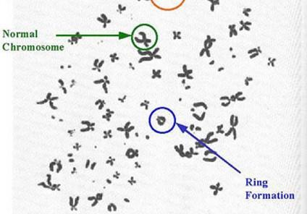
Radiation Effects - Ionisation
Direct ionisation
  Structural cell damage, weakens links between atoms
Indirect ionisation
  Damage to chemical constituents, e.g. water
  Formation of free radicals

Slide 20
Radiation effects
Stochastic effects (long-term): somatic and hereditary effects
  Effects will appear slowly because the body has time to heal itself after exposure. The effects, if any, will appear 20-30 years after exposure.
Deterministic effects (immediate): loss of function – also termed ‘Tissue Reactions’
  One-time event / High level doses involved (>100 rem or 1 Sv) / symptoms appear quickly (within days or weeks)

Slide 21
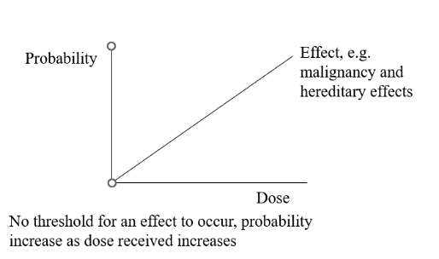
Stochastic Effects

Slide 22
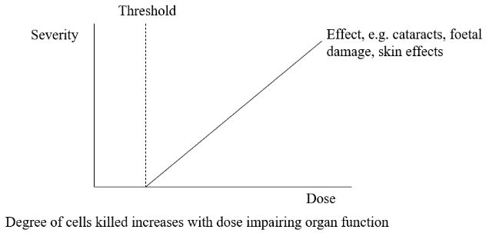
Harmful Tissue Reactions Effects

Slide 23
Harmful Tissue Reactions Effects
50 mSv - body repairs itself
1 Sv - nausea and vomiting
3 Sv - Erythema, blistering and ulceration
6 Sv - LD₅₀ depletion white blood cells, 50% population exposed die of infection death
10 Sv - severe depletion of cells lining intestine, death due to secondary infections

Slide 24
Radiation burns
Occur as a result of an acute localized exposure
Radiation burns can occur from a wide range of exposures and usually result from direct exposure to the primary beam. High-energy X-rays readily penetrate the outer layer of skin that contains most of the nerve endings, so you may not feel an X-ray burn until the damage has been done. Extreme cases involve skin grafts or amputation of fingers
The hands, fingers and eyes are the parts of the body most commonly at risk
The severity of the burn will depend on the dose received, the length of the exposure, the energy of the X-rays and the sensitivity of the individual

Slide 25
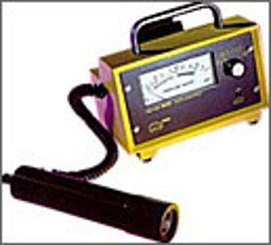
Monitoring

Slide 26
Instruments for detection of X-rays
Count rate meters – cpm / cps
Dose rate meters – µSv/hr, mSv/hr
Dosemeters – µSv, mSv

Slide 27
Types of Portable Monitors
Ion chambers
Scintillation detectors
Geiger-Muller Detectors

Slide 28
Instrument selection
Type of radiation
Energy of radiation
Range of radiation
Response time

Slide 29
Suitable Monitors
For Leakage Detection
  Thin scintillation crystal e.g., mini type 44 probe (>10keV for Al, >7keV for Be window)
  Uncompensated GM tube e.g., mini 900X
For Dose Rate Estimation
  Ionisation chamber (>7keV)
  Energy compensated GM e.g., mini900D

Slide 30
Pre-use Monitor Checks
Is it the correct type of equipment?
Is it in good repair?
Is the battery ok?
Does it have a reasonably low background count?
Is it in Calibration?

Slide 31
Personal Dosimetry
Whole body / skin – TLDs, PLDs
Eye dose – TLD chips
Extremities – Ring badges or TLD chips
Notes:
TLD = thermoluminescent dosimeter
PLD = photoluminescent dosimeter

Slide 32
External Radiation
Controlling the hazard:
Optimise shielding
Maximise distance
Minimise exposure
Minimise intensity

Slide 33
X-Ray Machine Terminology
The Primary / Useful Beam
The Primary or Useful Beam is the beam emitted by the X-ray tube after it passes through an aperture in the source housing
Shielding, such as a beam-stop, will prevent the primary beam from escaping the enclosure or damaging internal components of the XRD
The exposure area of the primary beam can be less than 1 cm²
The hands, fingers and eyes are the parts of the body most commonly at risk from primary beam exposure

Slide 34
X-ray Equipment – Closed beam
An analytical X-ray system in which all possible X-ray paths (primary, scatter and diffracted) are completely enclosed so that no part of the human body can be exposed to the beam during normal operation
The X-ray tube is installed in an enclosure which is intended to provide radiation shielding, and prevent access to its interior during generation of X-ray radiation
These units are the safest of the analytical X-ray units because they prevent exposure to the primary beam by including numerous safety interlocks
The enclosure also have built-in shielding within the unit to prevent exposure to scatter radiation

Slide 35
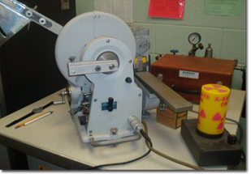
X-ray Equipment – Open beam
An analytical X-ray system that is not enclosed
An individual could accidentally place a part of the body in the primary beam path during normal operation
Open units present the greatest potential for injury because the primary beam is accessible to the user

Slide 36
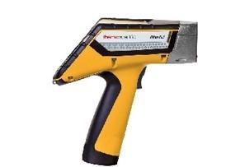
Portable X-ray Fluorescence Analysers (XRF)
Operated in an open-beam configuration, but the sample must be in contact with the XRF before the XRF will irradiate the sample
The XRF must have a built-in proximity sensor and backscatter detector
Both these safety devices are used to prevent accidently firing the x-ray without a sample placed against the beam port

Slide 37
Portable X-ray Fluorescence Analysers (XRF)
The Society for Radiological Protection (SRP) have produced guidance on the safe use of handheld XRF analysers (Pub. 2012)
This document is available on request from the University Radiation Protection Advisor

Slide 38
Safety Features – Machine Controls
Beam Shutter: Opens or closes, allowing or preventing the primary beam to pass
Beam Stop: composed of dense material (e.g. lead) that will absorb the primary beam that passes through and around the sample. This device works to stop the primary beam and reduce the scatter radiation that would be caused if the primary beam were to strike components of the unit housing
Fail-Safe Characteristics: a design feature which closes the beam port shutters or turns off the x-ray generator to prevent exposure to the primary beam upon failure of the safety warning device. All safety and warning device must be failsafe
“X-Ray On” light must be present and failsafe
Locks to the enclosure doors must be failsafe

Slide 39
Safety Features – Machine Controls continued
Beam Collimation: Focus the primary beam on the area of interest. Collimation prevents exposure to unwanted areas, reducing scatter radiation
Unit Enclosure: Equipment housing designed to prevent exposure from the primary beam. These enclosures may be fitted with leaded glass windows and safety interlocks which all work to prevent the operator from being exposed to the primary beam and secondary scatter radiation

Slide 40
Safety Features – Machine Controls continued
Interlocks: A series of switches and circuits that must all be connected in order for the primary beam to operate. The switches are generally connected to the warning lights, doors, beam shutter and collimator. If any of these switches are triggered and opened, the beam will shut down
Standard Operating Procedures: Step-by-step instructions necessary to accomplish the analysis. These procedures shall include sample insertion, manipulation, equipment alignment, routine maintenance by registrant, and data-recording procedures which are related to radiation safety

Slide 41
X-ray Unit Safety Features
The safety features of X-ray units will vary depending on the type of unit being employed (i.e. cabinet, closed beam, open-beam, XRF)
Open-beam units have the highest potential for dangerous exposures to occur because they allow the user to have access to the primary beam
Closed-beam and cabinet units are much safer to work with because they have safety features preventing the user from accessing the primary beam

Slide 42
X-ray Unit Safety Features continued
All enclosed X-ray units include the necessary safety features needed to prevent access to the primary beam and keep the potential exposures to the user at safe levels
Portable XRF’s require adherence to special safety practices and procedures to avoid exposure to the primary beam
Familiarise yourself with your unit’s safety features prior to use

Slide 43
Safety Practices
Never bypass a safety device such as interlocks and failsafe features, shutters, etc. without approval from the School / Service Radiation Protection Supervisor, as such devices are meant to protect you from serious harm and injury
Understand the risk assessment and controls measures relating to the x-ray unit you operate
Learn the Standard Operating Procedures for each X-ray unit you operate

Slide 44
Safety Practices continued
Do not operate a unit in any manner other then specified in the Standard Operating Procedures
Do not allow anyone other than trained and certified personnel to operate the unit
Always follow the ALARP principles: Time, Distance, Shielding, Dosimetry

Slide 45
Safety Practices continued
Do not remove covers, shielding material or tube housing or perform modifications to shutters, collimators or beam stops without verifying the x-ray tube is off and will remain off until safe conditions have been restored. The main on / off switch, rather than interlocks, must be used for routine shutdown
Never place any part of your body in the primary beam
Never use hands to hold a sample e.g. sample analysis with a handheld XRF

Slide 46
Safety Practices continued
Do not attempt to operate if the X-ray unit is not mechanically intact and sound
Always control access to radiation producing equipment during use to avoid unintentional exposures
Always know the location and presence of the primary and diffracted / scattered X-ray beams

Slide 47
X-ray Safety Film
It is recommended all users of X-ray generating equipment view the following safety film
right click on the title below and select ‘open link’ to watch the film via YouTube
The Double Edged Sword Video

Slide 48
University of Bristol Arrangements
All users of sources of ionising radiation must register on the central University Radioactive Sources database and ensure their registration is reviewed every year
Risk assessments for use of x-ray generating equipment may be recorded on the central Radioactive Source Database, electronically, or paper copy, depending on the School / Service
All users must sign-off risk assessments to state that they have read and understood all control measures required for safe operation

Slide 49
Accidents / Incidents
Report from an x-ray radiation incident in France: Accidental exposure of researchers’ hands to an X-­ray crystallography beam
Incident
During a crystallography analysis, two people handled the sample when the X-ray diffraction device was on
The collimator and beam stop, which was normally used to provide protection, had been removed

Slide 50
Accidents / Incidents continued
The two people did not realise that the device was on
The exposure time was estimated at 40 seconds and the distance between the X-ray source and the persons was approximately 40 cm
It is estimated that the hands crossed the X-ray beam on several occasions

Slide 51
Radiological Consequences
The handlers were not wearing personal dosimeters.
A reconstruction of the incident with two film badges revealed :
  an equivalent dose of 480 mSv to the hands - approximately equal to the annual limit for workers - 500 mSv/year
  an effective dose of less than 0.1 mSv at the chest

Slide 52
Lessons learned and recommendations
On this kind of equipment, the dose rate in the main beam can be extremely high, and can give rise to very high localised exposures of the hands from handling the sample while the equipment is turned on
For this reason, it is expected that units will be fitted with a robust safety and warning system to physically prevent access to the beam. The removal of any component of this system should cause the X-ray beam to be terminated/shielded

Slide 53
Lessons learned and recommendations continued
During certain maintenance operations, it may be necessary to override certain safety systems, thus allowing potential access to the beam
In such cases, personal dosimetry especially for the hands/fingers is recommended
Dosemeters may not be exposed to very narrow beams, and a radiation monitor should always be used to confirm the radiological conditions

Slide 54
Local X-ray Equipment and School Arrangements
School / Service RPS to add notes detailing:
  X-ray generating equipment in use, location, access arrangements, warning signs etc.
  induction and local training requirements including sign-off (e.g., form RP16 – local training record)
  Risk assessment and Safe System of Work
  Recorded equipment safety checks, use log etc.

